Slide 1
Subcommittee for Disaster Reduction
Hurricane Supplemental
National Weather Service
Mary Erickson Deputy Director

Slide 2
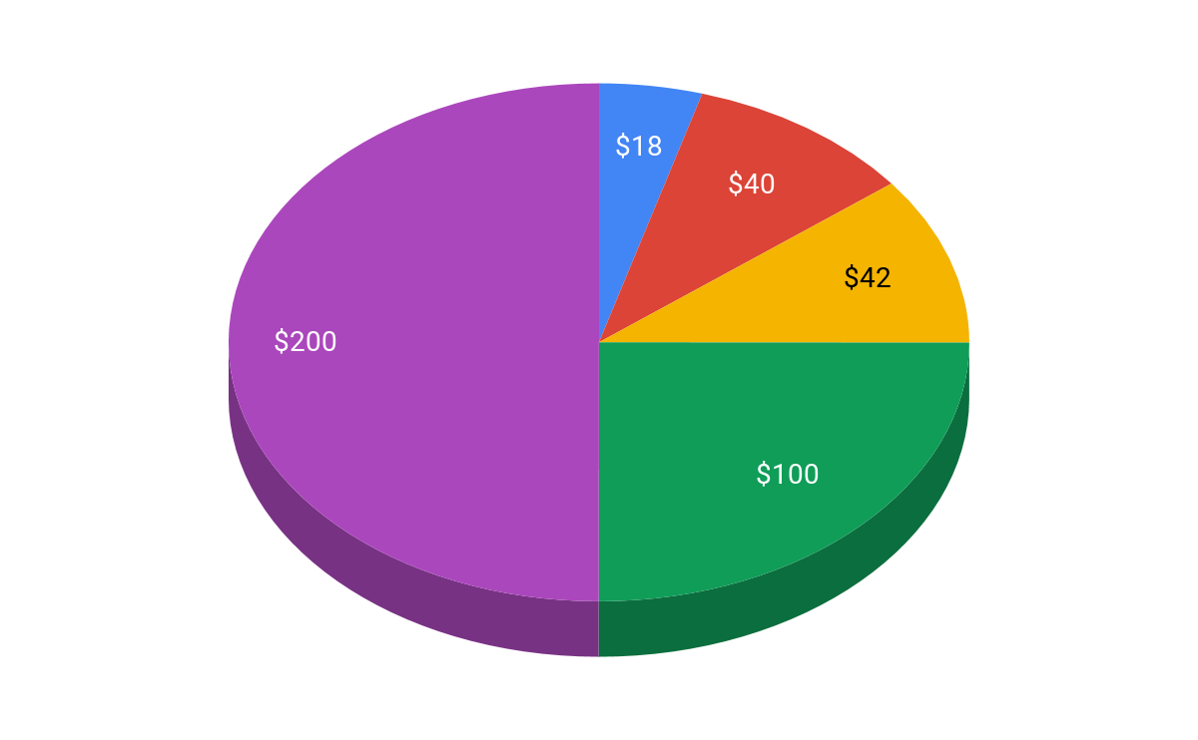
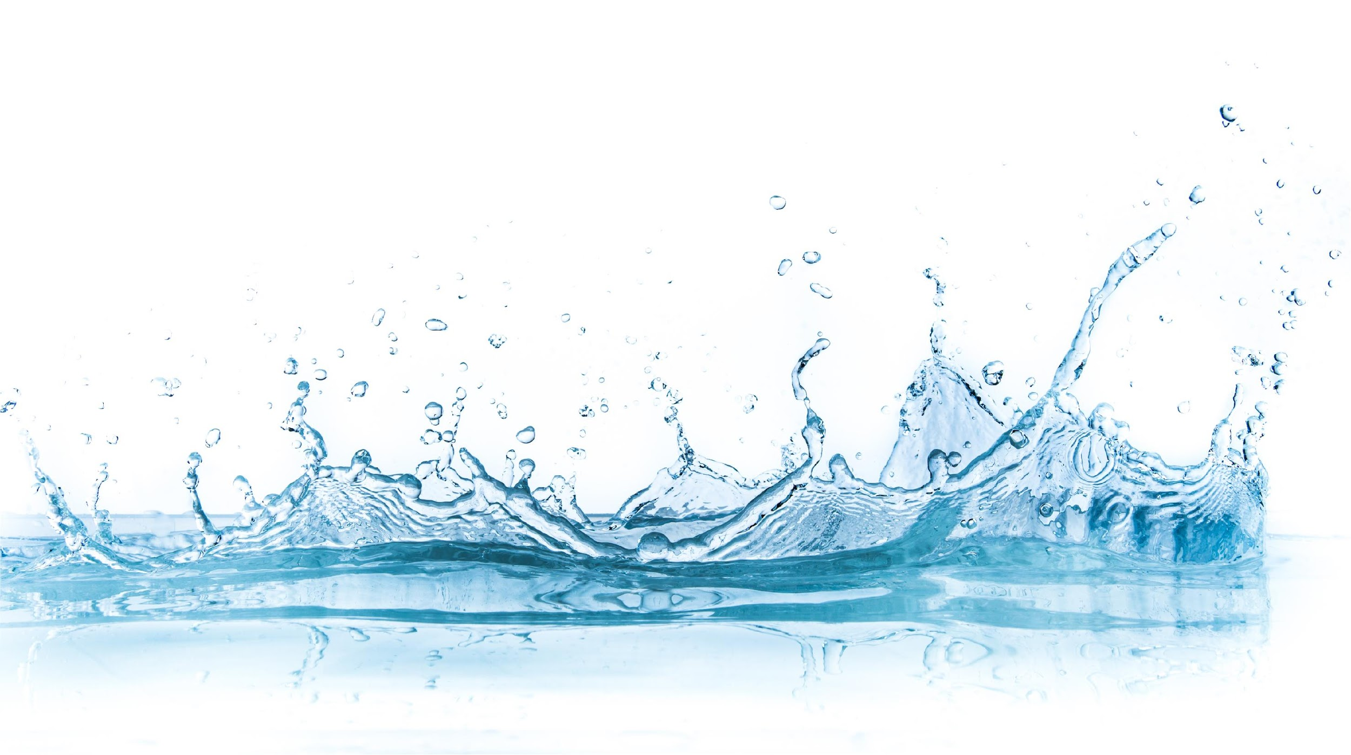
Supplemental
NOAA $400M
$18 million for assessments and removal of marine debris
$40 million for mapping and charting affected coastlines and channels
$42.1 million to repair or replace federal facilities and observing assets
$100 million for improving weather forecasting capabilities and data collection efforts
$200 million for fishery disasters causing severe economic harm in coastal communities

Slide 3
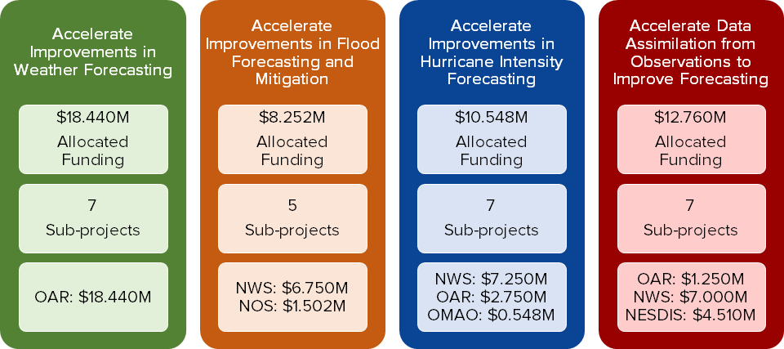
Overview:
The NOAA spend plan provides $50M for the Improving Forecasting and Assimilation (IFAA) Portfolio. There will be 26 projects across four primary focus areas:
An additional $50M provided for repair and facilities improvements.

